Slide 1



Coffee shopSalesData Analysis
Hanover and Tyke
Home
Service
By Shamal Vidhate

Slide 2



Hanover and Tyke
Home
Service
About Us
Contact
Introduction
This project aims to analyze sales data from a coffee shop to gain insights into revenue, customer behavior, and product performance. Using SQL queries, we extract key metrics and trends to improve business decision-making.
Objectives :
1. Understand Sales Performance : Idenfity peak sales periods, Top-selling product , and Overall sales trend.
2. Optimize Operation : Discover Insights that can help in optimizing inventory, staffing , and promotional strategies.

Slide 3





Hanover and Tyke
Home
Service
About Us
Contact
scope of Analysis
Data Dimensions: The Analysis will cover variours dimension such as
Sales by hour of the day.
Sales by day of the week.
Product sales performance.
Sales distribution by Store Location.

Slide 4



Hanover and Tyke
Home
Service
About Us
Contact
Coffee Sales Data Overview
Table size and structure
Total Rows : 1,49,456
Total Columns : 11
Columns Overview
Transaction_id
Transaction Date
Transaction Time
Transaction Quantity
Store ID
Store location
Product ID
Unit Price
Product category
Product Type
Product Details

Slide 5
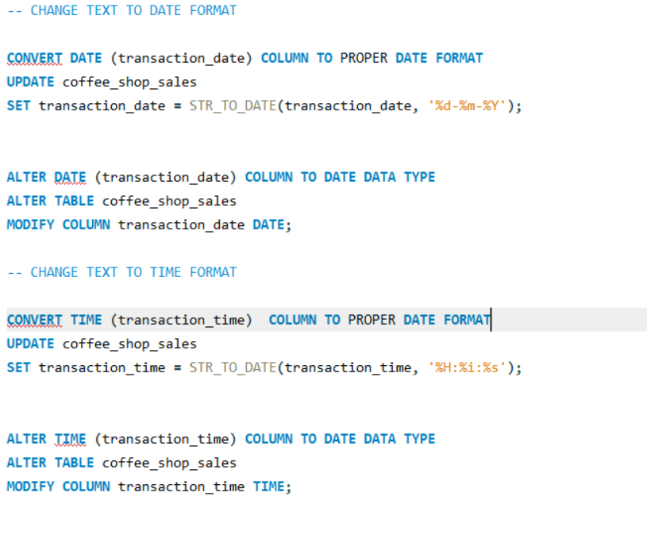
Hanover and Tyke
Home
Service
About Us
Contact
QUERIES USED FOR DATA TYPE TRANSFORMATION

Slide 6
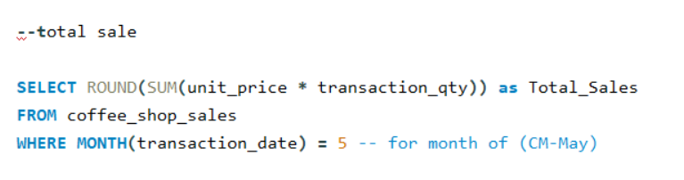
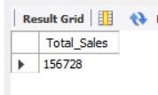
TOTAL SALES
QUERY
OUTPUT

Slide 7
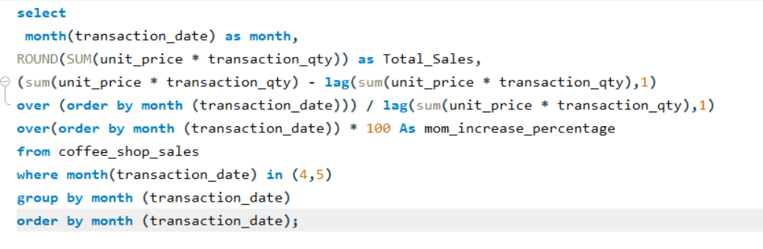
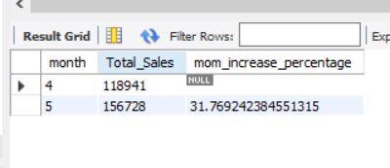
TOTAL SALES KPI - MOM DIFFERENCE AND MOM GROWTH
QUERY
OUTPUT

Slide 8
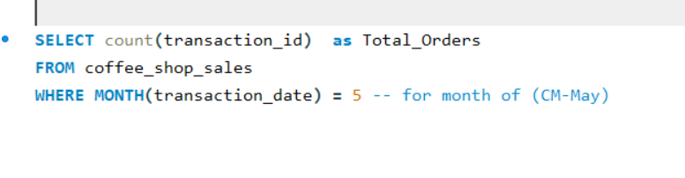
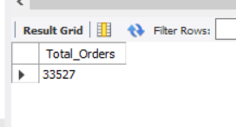
TOTAL ORDERS
QUERY
OUTPUT

Slide 9
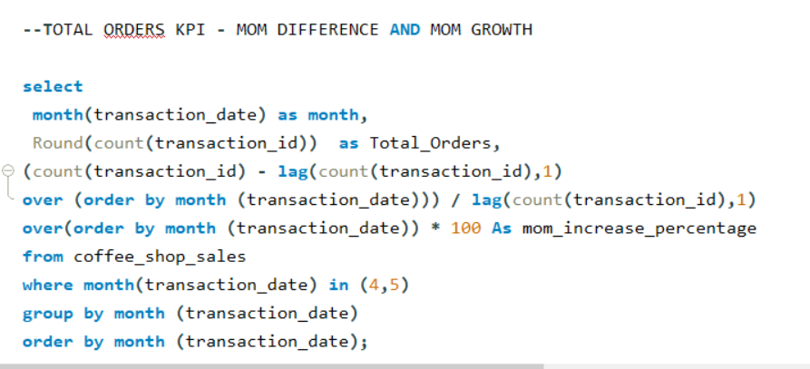
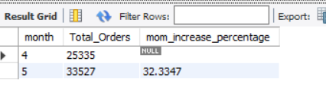
TOTAL ORDERS KPI - MOM DIFFERENCE AND MOM GROWTH
QUERY
OUTPUT

Slide 10
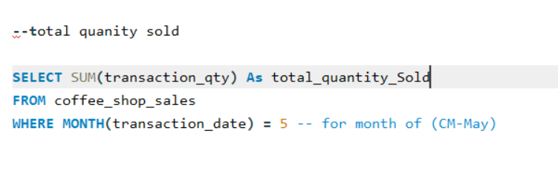
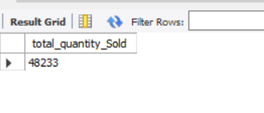
TOTAL QUANTITY SOLD
QUERY
OUTPUT

Slide 11
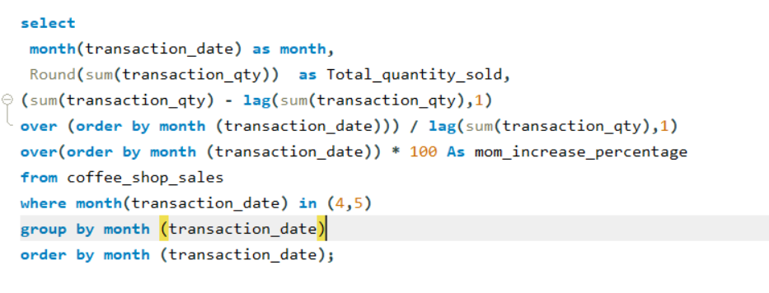
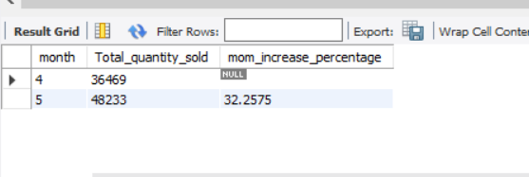
TOTAL QUANTITY SOLD KPI - MOM DIFFERENCE AND MOM GROWTH
QUERY
OUTPUT

Slide 12
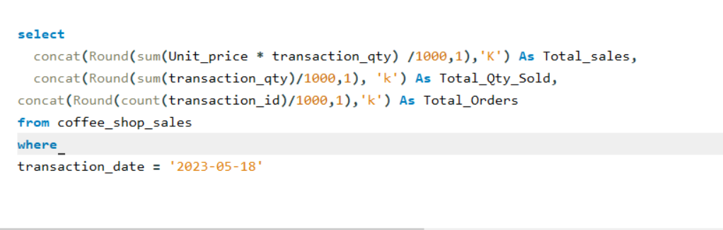
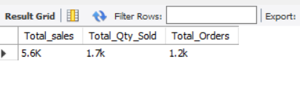
CALENDAR TABLE – DAILY SALES, QUANTITY and TOTAL ORDERS
QUERY
OUTPUT

Slide 13
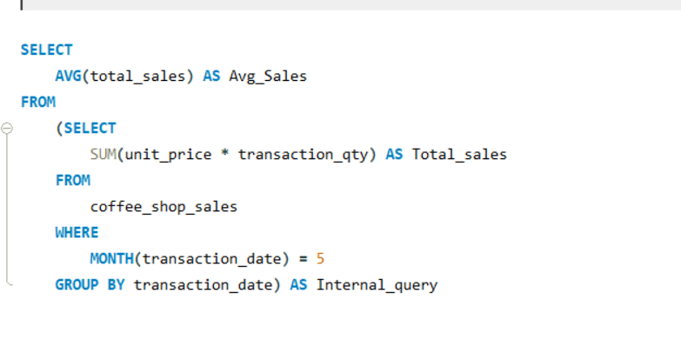
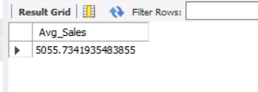
SALES TREND OVER PERIOD
QUERY
OUTPUT

Slide 14
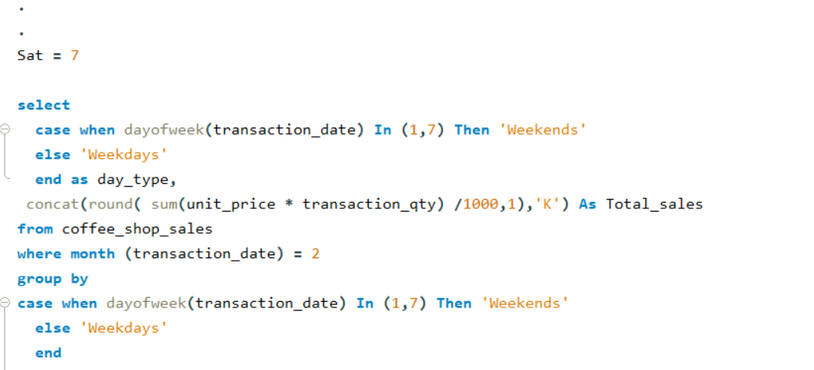
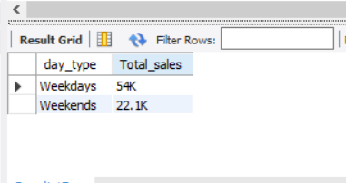
SALES BY WEEKDAY / WEEKEND:
QUERY
OUTPUT

Slide 15
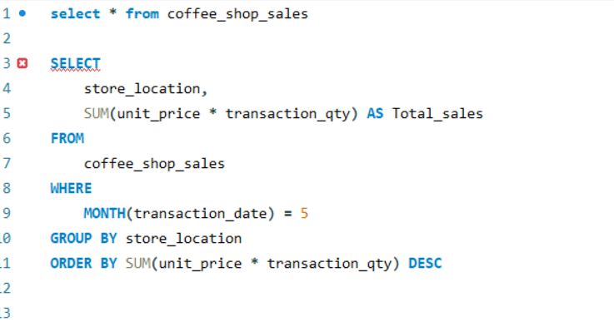
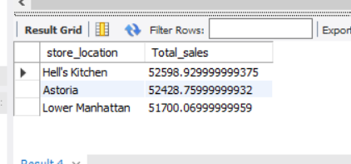
SALES BY STORE LOCATION
QUERY
OUTPUT

Slide 16
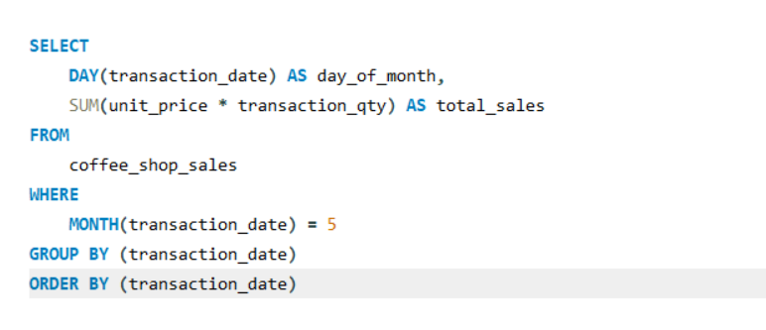
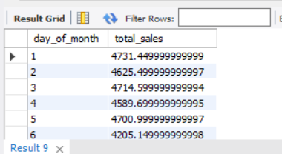
DAILY SALES FOR MONTH SELECTED
QUERY
OUTPUT

Slide 17
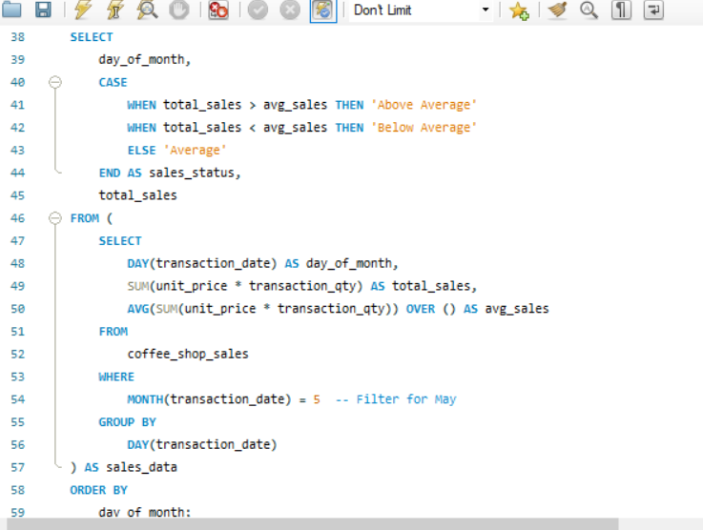
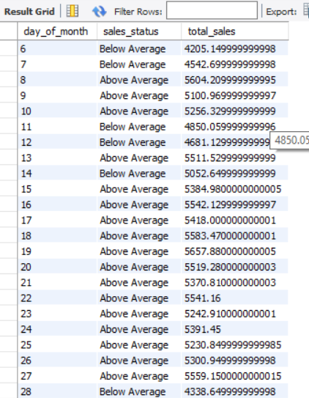
COMPARING DAILY SALES WITH AVERAGE SALES – IF GREATER THAN “ABOVE AVERAGE” and LESSER THAN “BELOW AVERAGE”
QUERY
OUTPUT

Slide 18
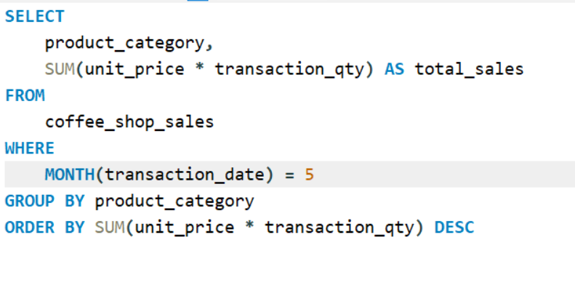
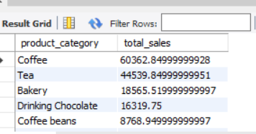
SALES BY PRODUCT CATEGORY
QUERY
OUTPUT

Slide 19
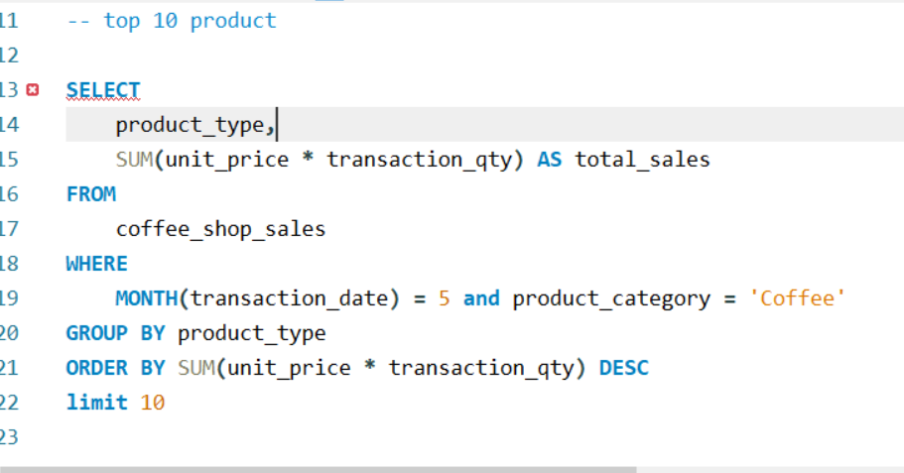
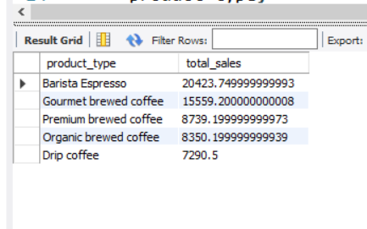
SALES BY PRODUCTS (TOP 10)
QUERY
OUTPUT

Slide 20
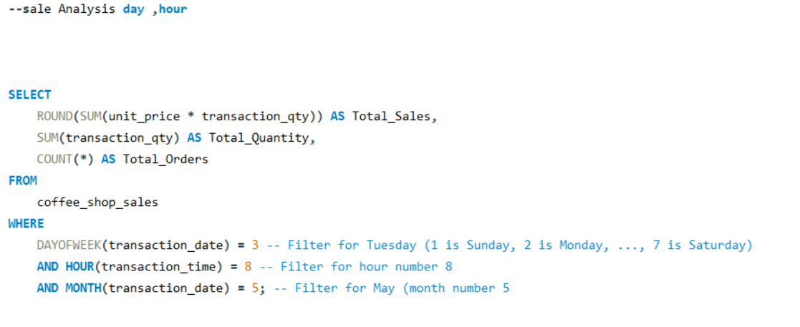
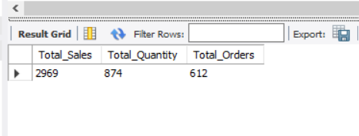
SALES BY DAY | HOUR
QUERY
OUTPUT

Slide 21
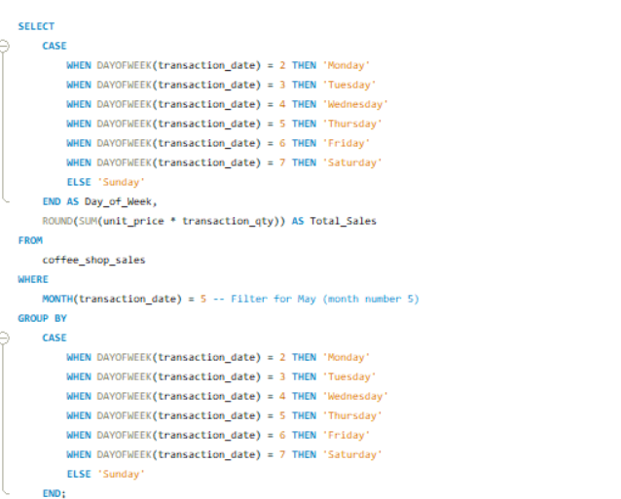
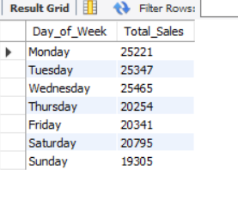
TO GET SALES FROM MONDAY TO SUNDAY FOR MONTH OF MAY
QUERY
OUTPUT

Slide 22
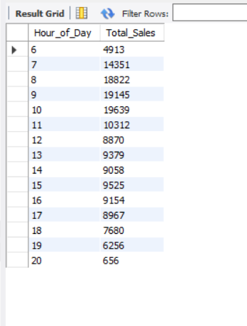
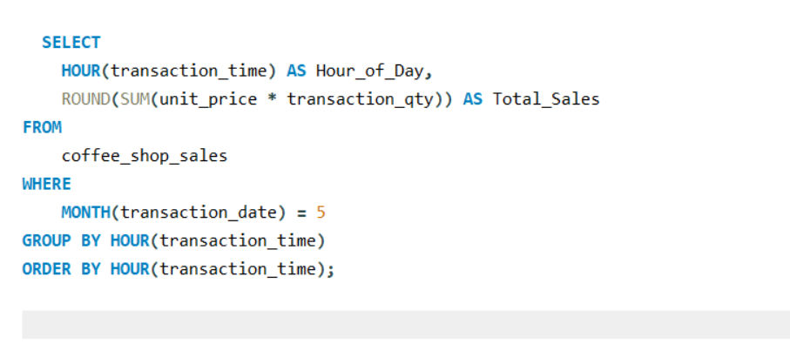
TO GET SALES FOR ALL HOURS FOR MONTH OF MAY
OUTPUT
QUERY

Slide 23


Thank You

